Slide 1
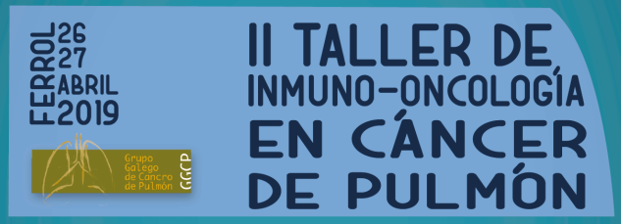
Toxicidades dermatológicas de la inmunoterapia del cáncer de pulmón
Dra. María del Pilar Arévalo Bermúdez, MD, PhD
Complejo Hospitalario Universitario A Coruña

Slide 2
Conflicto de Intereses
 | Almirall | Isdin | Pierre Fabré | Leo Pharma | Novartis | Sanofi | Viñas
Advisory Board
Travel & Accomodation | X | X | X | X | X | X | X
Honoraria |  | X |  | X | X
Grant
Los contenidos de esta presentación reflejan mi punto de vista sobre este tema y no necesariamente el de los sponsors de esta reunión

Slide 3
Toxicidad cutánea por inhibidores de puntos de regulación de la respuesta inmune (ICPi)
Son los efectos adversos más prevalentes:
Anti-CTLA-4 > anti-PD1 > anti-PDL-1
Michot JM et al. European Journal of Cancer 54 (2016) 139e148
Khoja L et al. Annals of Oncology 2017; 28: 2377–2385,
Notes:
Dermatologic toxicities appear to be the most prevalent
irAEs, both with anti-PD-1 (nivolumab and pembrolizumab)
and anti-CTLA-4 (ipilimumab, tremelimumab)
agents and with the newly developed anti-PD-L1
agents (atezolizumab, durvalumab, avelumab) [2–11].
They occur in more than one-third of the patients treated
with these monoclonal antibodies (Table 1), regardless of
the cancer being treated [4, 9, 11–18]. The vast majority of
these cutaneous adverse events, however, are self-limiting,
and immune checkpoint inhibitors present an acceptable
skin toxicity profile [13–20]. Although the overall
incidence is higher with ipilimumab compared to anti-PD-1
or anti-PD-L1 agents, the dermatologic toxicity profile is
very similar and above all corresponds with a class effect
[4, 9, 12]: maculopapular rash (spongiotic and lichenoid
dermatitis), vitiligo (only among patients with melanoma),
induced psoriasis, auto-immune skin diseases, etc. In dermatologic toxicities are the first to occur with
immune checkpoint inhibitors [2, 4, 5, 7, 11], and this does
not appear to be dose dependent [10, 20, 21]. Lastly,
cutaneous irAEs observed with anti-CTLA-4/anti-PD-1
used in combination (e.g., ipilimumab and nivolumab) are
more frequent, more severe, and long lasting and develop
earlier compared to PD-1 or CTLA-4 inhibitors prescribed
as single agents
The most common irAE for both CTLA-4 and PD-1 therapy
involves dermatologic toxicity, which is also typically the irAE with the
earliest onset, within several weeks (as reviewed for CTLA-4 by Weber
et al54)
Dermatologic toxicities appear to be the most prevalent
irAEs, both with anti-PD-1 (nivolumab and pembrolizumab)
and anti-CTLA-4 (ipilimumab, tremelimumab)
agents and with the newly developed anti-PD-L1
agents (atezolizumab, durvalumab, avelumab) [2–11]. Con los cual es un efecto de clase
They occur in more than one-third of the patients treated
with these monoclonal antibodies (Table 1), regardless of
the cancer being treated [4, 9, 11–18]. The vast majority of
these cutaneous adverse events, however, are self-limiting,
and immune checkpoint inhibitors present an acceptable
skin toxicity profile [13–20]. Although the overall
incidence is higher with ipilimumab compared to anti-PD-1
or anti-PD-L1 agents, the dermatologic toxicity profile is
very similar
Finally, it needs to be emphasized that the occurrence of
some of these cutaneous reactions induced by anti-PD-1
appear to be correlated with a better therapeutic response,
in terms of objective response (vitiligo) [22], progressionfree
survival (cutaneous adverse events all together) [20] or
overall survival (maculopapular rash and vitiligo)
approximately 40–46% of patients with melanoma4 and 41% of patients with renal cell carcinoma5 will develop cutaneous
irAEs associated with anti-PD-1 therapy, as compared to 17% in patients with non-small cell lung cancer (NSCLC)4 and 18% of patients with squamous-cell carcinoma of the head and neck
Dermatologic toxicity
of any grade may be seen in up to 49–68% of
patients undergoing ipilimumab treatment,8–10
and a meta-analysis by Minkis et al.11 reported
an overall risk of 24%. Similarly, skin rash may
be seen in ∼20% of patients treated with the
anti-PD-1 antibody nivolumab.2,1
In fact, more than two
thirds of patients may develop maculopapular
eruptions (in contrast to the papulopustular
eruptions in the former) during ipilimumab
therapy, reminiscent of the dermal hypersensitivity
reaction (DHR) typically encountered
with antibiotics, non-steroidal anti-inflammatory
medications and targeted therapy with PI3K
and AKT inhibitors.

Slide 4
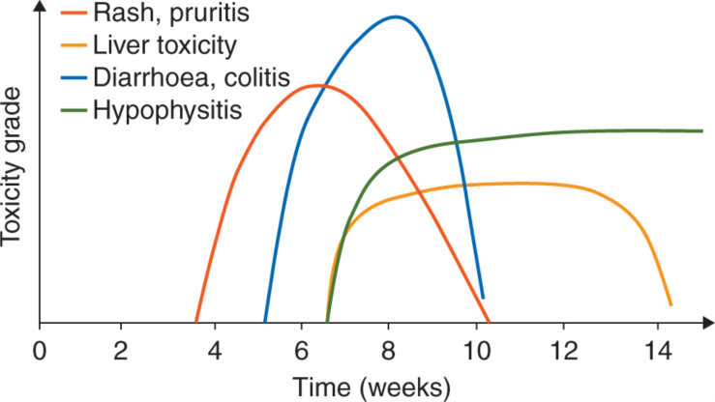
Toxicidad cutánea por inhibidores de puntos de regulación de la respuesta inmune (ICPi)
Dosis dependiente anti CTLA-4/ No para anti PD-1 y PD-L1
Efecto acumulativo
Suelen ser los primeros en aparecer
Haanen JBAEG et al. Ann Oncol.2017;28(suppl_4):iv119-iv142.
Notes:
The toxicity profile of ipilimumab is dose-dependent, and patients who
received 10 mg/kg of ipilimumab every 3 weeks
experienced higher rates of cutaneous irAE
of any grade (17% for 3 mg/kg vs. 93% for
10 mg/kg).19 Dermatologic toxicity is the most
frequent and commonly the first manifestation
of ipilimumab therapy, with irAE of the skin
occurring on average within 21–42 days, followed
by gastrointestinal toxicity that appears at
35–49 days after initiation of therapy.7
Skin adverse reactions can appear on average at 3.6
weeks after the initiation of the immunotherapy and usually
resolve within 4-8 or 14 weeks when managed with treatment
guidelines using vigilant monitoring and corticosteroids
[5]. They are usually present in the first 2-3 weeks after
the beginning of therapy with IPI, with a variation of up to
17.3 weeks, and are dose-dependent [6, 9]. On administration
of anti-PD1/PD-L1 agents, they appear later and typically
after the second cycle of treatment, on average 4-23
weeks after the beginning of therapy. Delayed effects up to 1
year after the initiation of treatment with anti-PD-1 agents
has been reported
Dermatologic toxicities appear to be the most prevalent
irAEs, both with anti-PD-1 (nivolumab and pembrolizumab)
and anti-CTLA-4 (ipilimumab, tremelimumab)
agents and with the newly developed anti-PD-L1
agents (atezolizumab, durvalumab, avelumab) [2–11].
They occur in more than one-third of the patients treated
with these monoclonal antibodies (Table 1), regardless of
the cancer being treated [4, 9, 11–18]. The vast majority of
these cutaneous adverse events, however, are self-limiting,
and immune checkpoint inhibitors present an acceptable
skin toxicity profile [13–20]. Although the overall
incidence is higher with ipilimumab compared to anti-PD-1
or anti-PD-L1 agents, the dermatologic toxicity profile is
very similar and above all corresponds with a class effect
[4, 9, 12]: maculopapular rash (spongiotic and lichenoid
dermatitis), vitiligo (only among patients with melanoma),
induced psoriasis, auto-immune skin diseases, etc. In dermatologic toxicities are the first to occur with
immune checkpoint inhibitors [2, 4, 5, 7, 11], and this does
not appear to be dose dependent [10, 20, 21]. Lastly,
cutaneous irAEs observed with anti-CTLA-4/anti-PD-1
used in combination (e.g., ipilimumab and nivolumab) are
more frequent, more severe, and long lasting and develop
earlier compared to PD-1 or CTLA-4 inhibitors prescribed
as single agents
The most common irAE for both CTLA-4 and PD-1 therapy
involves dermatologic toxicity, which is also typically the irAE with the
earliest onset, within several weeks (as reviewed for CTLA-4 by Weber
et al54)
Dermatologic toxicities appear to be the most prevalent
irAEs, both with anti-PD-1 (nivolumab and pembrolizumab)
and anti-CTLA-4 (ipilimumab, tremelimumab)
agents and with the newly developed anti-PD-L1
agents (atezolizumab, durvalumab, avelumab) [2–11]. Con los cual es un efecto de clase
They occur in more than one-third of the patients treated
with these monoclonal antibodies (Table 1), regardless of
the cancer being treated [4, 9, 11–18]. The vast majority of
these cutaneous adverse events, however, are self-limiting,
and immune checkpoint inhibitors present an acceptable
skin toxicity profile [13–20]. Although the overall
incidence is higher with ipilimumab compared to anti-PD-1
or anti-PD-L1 agents, the dermatologic toxicity profile is
very similar
Finally, it needs to be emphasized that the occurrence of
some of these cutaneous reactions induced by anti-PD-1
appear to be correlated with a better therapeutic response,
in terms of objective response (vitiligo) [22], progressionfree
survival (cutaneous adverse events all together) [20] or
overall survival (maculopapular rash and vitiligo)
approximately 40–46% of patients with melanoma4 and 41% of patients with renal cell carcinoma5 will develop cutaneous irAEs associated with anti-PD-1 therapy, as compared to 17% in patients with non-small cell lung cancer (NSCLC)4 and 18% of patients with squamous-cell carcinoma of the head and neck
In fact, more than two
thirds of patients may develop maculopapular
eruptions (in contrast to the papulopustular
eruptions in the former) during ipilimumab
therapy, reminiscent of the dermal hypersensitivity
reaction (DHR) typically encountered
with antibiotics, non-steroidal anti-inflammatory
medications and targeted therapy with PI3K
and AKT inhibitors.
Clinical
trials have shown anti-PD-L1 antibody therapy
shares a toxicity profile with anti-PD-1 antibody
therapy.53 Skin rash NOS (7%), pruritus (6%)
and vitiligo (2%) were the three most frequent
dermatologic toxicities (of any grade) in patients
treated with anti-PD-L1 antibody (at any dose
between 0.3 and 10 mg/kg).

Slide 5
Toxicidad cutánea por inhibidores de puntos de regulación de la respuesta inmune (ICPi)
JAMA Dermatology 2018. doi:10.1001/jamadermatol.2018.1912
Notes:
A wide range of timing of onset of cutaneous irAEs was
observed in our cohort (Tables 1 and 2). Specifically, time
from treatment initiation to reaction ranged from 0.5 to 38.0
months. The median time to onset of all 18 skin reactions
(including 2 in patient 10) was 4.2 months (interquartile
range [IQR], 2.3-13.8 months). The median time to onset
after PD-1 therapy was similar for pembrolizumab (3.8
months [IQR, 2.6-11.1 months]) and for nivolumab (4.4
months [IQR, 1.0-18.3 months]), without statistically significant
differences between the groups. One skin reaction
occurred in the patient who received pembrolizumab and
nivolumab (time to onset, 4.7 months). Of 12 skin reactions
in patients treated with pembrolizumab, 4 (33%) developed
after treatment termination, as did the single reaction in the
patient treated with both drugs (total, 5 of 18 [28%]).
Patientswhohad a complete response developed cutaneous
Our findings indicate that a wide range of timelines is associated
with cutaneous irAEs after PD-1 inhibitor therapy. A
delayed onset of cutaneous irAEs (≥3 months) is common.
We also found that PD-1 inhibitor–associated cutaneous
irAEs may occur after treatment discontinuation. Although
skin reactions occurring after medication discontinuation
cannot be definitively proven to be caused by PD-1 inhibitors,
in our cohort these reactions were of the type frequently
attributed to pembrolizumab and nivolumab
(sarcoidosis, lichenoid dermatitis, bullous pemphigoid,
and erythema multiforme). Prolonged tumor responses associated with persistence
of immune reactivation and tumor targeting suggest
that irAEs may appear after discontinuation of therapy as
well. These characteristics are shared by other immunotherapy
agents because responses to ipilimumab are similarly prolonged after discontinuation.
The mean elimination half-life of both pembrolizumab
and nivolumab is approximately 26 days,15 but the effects of
PD-1 inhibitors almost certainly last longer. aware that cutaneous irAEs may occur long after initiation of
PD-1 therapy and may appear after discontinuation.
irAEs a median of 4.4 months after initiation of therapy
(IQR, 2.3-16.0 months). Patients who had progression of disease
developed cutaneous irAEs a median of 4.7months after
initiation of therapy (IQR, 2.0-16.7 months). No differences
were identified between response groups.

Slide 6
Toxicidad cutánea por inhibidores de puntos de regulación de la respuesta inmune (ICPi)
Efecto de clase
Efectos adversos cutáneos con la combinación de ICPi:
Más frecuentes
Más severos
Más precoces y de más larga duración
Sibaud V. Am J Clin Dermatol 2018;19:345-61
Notes:
Dermatologic toxicities appear to be the most prevalent
irAEs, both with anti-PD-1 (nivolumab and pembrolizumab)
and anti-CTLA-4 (ipilimumab, tremelimumab)
agents and with the newly developed anti-PD-L1
agents (atezolizumab, durvalumab, avelumab) [2–11].
They occur in more than one-third of the patients treated
with these monoclonal antibodies (Table 1), regardless of
the cancer being treated [4, 9, 11–18]. The vast majority of
these cutaneous adverse events, however, are self-limiting,
and immune checkpoint inhibitors present an acceptable
skin toxicity profile [13–20]. Although the overall
incidence is higher with ipilimumab compared to anti-PD-1
or anti-PD-L1 agents, the dermatologic toxicity profile is
very similar and above all corresponds with a class effect
[4, 9, 12]: maculopapular rash (spongiotic and lichenoid
dermatitis), vitiligo (only among patients with melanoma),
induced psoriasis, auto-immune skin diseases, etc. In dermatologic toxicities are the first to occur with
immune checkpoint inhibitors [2, 4, 5, 7, 11], and this does
not appear to be dose dependent [10, 20, 21]. Lastly,
cutaneous irAEs observed with anti-CTLA-4/anti-PD-1
used in combination (e.g., ipilimumab and nivolumab) are
more frequent, more severe, and long lasting and develop
earlier compared to PD-1 or CTLA-4 inhibitors prescribed
as single agents
The most common irAE for both CTLA-4 and PD-1 therapy
involves dermatologic toxicity, which is also typically the irAE with the
earliest onset, within several weeks (as reviewed for CTLA-4 by Weber
et al54)
Dermatologic toxicities appear to be the most prevalent
irAEs, both with anti-PD-1 (nivolumab and pembrolizumab)
and anti-CTLA-4 (ipilimumab, tremelimumab)
agents and with the newly developed anti-PD-L1
agents (atezolizumab, durvalumab, avelumab) [2–11]. Con los cual es un efecto de clase
They occur in more than one-third of the patients treated
with these monoclonal antibodies (Table 1), regardless of
the cancer being treated [4, 9, 11–18]. The vast majority of
these cutaneous adverse events, however, are self-limiting,
and immune checkpoint inhibitors present an acceptable
skin toxicity profile [13–20]. Although the overall
incidence is higher with ipilimumab compared to anti-PD-1
or anti-PD-L1 agents, the dermatologic toxicity profile is
very similar
Finally, it needs to be emphasized that the occurrence of
some of these cutaneous reactions induced by anti-PD-1
appear to be correlated with a better therapeutic response,
in terms of objective response (vitiligo) [22], progressionfree
survival (cutaneous adverse events all together) [20] or
overall survival (maculopapular rash and vitiligo)
approximately 40–46% of patients with melanoma4 and 41% of patients with renal cell carcinoma5 will develop cutaneous
irAEs associated with anti-PD-1 therapy, as compared to 17% in patients with non-small cell lung cancer (NSCLC)4 and 18% of patients with squamous-cell carcinoma of the head and neck

Slide 7
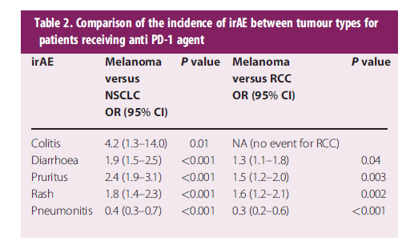
Toxicidad cutánea por inhibidores de puntos de regulación de la respuesta inmune (ICPi)
Tipo de tumor:
Anti PD-1: Melanoma (40-46%) y Ca renal (41%) > CPNCP (17%) y Ca Cabeza/Cuello epidermoide (18%)
Kaunitz GJ. Am J Surg Pathol. 2017 October ; 41(10): 1381–1389
CPNCP: Ca de pulmón no células pequeñas
Khoja L et al. Annals of Oncology 2017; 28: 2377–2385,
Notes:
Skin adverse reactions can appear on average at 3.6
weeks after the initiation of the immunotherapy and usually
resolve within 4-8 or 14 weeks when managed with treatment
guidelines using vigilant monitoring and corticosteroids
[5]. They are usually present in the first 2-3 weeks after
the beginning of therapy with IPI, with a variation of up to
17.3 weeks, and are dose-dependent [6, 9]. On administration
of anti-PD1/PD-L1 agents, they appear later and typically
after the second cycle of treatment, on average 4-23
weeks after the beginning of therapy. Delayed effects up to 1
year after the initiation of treatment with anti-PD-1 agents
has been reported
Dermatologic toxicities appear to be the most prevalent
irAEs, both with anti-PD-1 (nivolumab and pembrolizumab)
and anti-CTLA-4 (ipilimumab, tremelimumab)
agents and with the newly developed anti-PD-L1
agents (atezolizumab, durvalumab, avelumab) [2–11].
They occur in more than one-third of the patients treated
with these monoclonal antibodies (Table 1), regardless of
the cancer being treated [4, 9, 11–18]. The vast majority of
these cutaneous adverse events, however, are self-limiting,
and immune checkpoint inhibitors present an acceptable
skin toxicity profile [13–20]. Although the overall
incidence is higher with ipilimumab compared to anti-PD-1
or anti-PD-L1 agents, the dermatologic toxicity profile is
very similar and above all corresponds with a class effect
[4, 9, 12]: maculopapular rash (spongiotic and lichenoid
dermatitis), vitiligo (only among patients with melanoma),
induced psoriasis, auto-immune skin diseases, etc. In dermatologic toxicities are the first to occur with
immune checkpoint inhibitors [2, 4, 5, 7, 11], and this does
not appear to be dose dependent [10, 20, 21]. Lastly,
cutaneous irAEs observed with anti-CTLA-4/anti-PD-1
used in combination (e.g., ipilimumab and nivolumab) are
more frequent, more severe, and long lasting and develop
earlier compared to PD-1 or CTLA-4 inhibitors prescribed
as single agents
The most common irAE for both CTLA-4 and PD-1 therapy
involves dermatologic toxicity, which is also typically the irAE with the
earliest onset, within several weeks (as reviewed for CTLA-4 by Weber
et al54)
Dermatologic toxicities appear to be the most prevalent
irAEs, both with anti-PD-1 (nivolumab and pembrolizumab)
and anti-CTLA-4 (ipilimumab, tremelimumab)
agents and with the newly developed anti-PD-L1
agents (atezolizumab, durvalumab, avelumab) [2–11]. Con los cual es un efecto de clase
They occur in more than one-third of the patients treated
with these monoclonal antibodies (Table 1), regardless of
the cancer being treated [4, 9, 11–18]. The vast majority of
these cutaneous adverse events, however, are self-limiting,
and immune checkpoint inhibitors present an acceptable
skin toxicity profile [13–20]. Although the overall
incidence is higher with ipilimumab compared to anti-PD-1
or anti-PD-L1 agents, the dermatologic toxicity profile is
very similar
Finally, it needs to be emphasized that the occurrence of
some of these cutaneous reactions induced by anti-PD-1
appear to be correlated with a better therapeutic response,
in terms of objective response (vitiligo) [22], progressionfree
survival (cutaneous adverse events all together) [20] or
overall survival (maculopapular rash and vitiligo)
approximately 40–46% of patients with melanoma4 and 41% of patients with renal cell carcinoma5 will develop cutaneous irAEs associated with anti-PD-1 therapy, as compared to 17% in patients with non-small cell lung cancer (NSCLC)4 and 18% of patients with squamous-cell carcinoma of the head and neck

Slide 8
Toxicidad cutánea por inhibidores de puntos de regulación de la respuesta inmune (ICPi)
Khoja L et al. Annals of Oncology 2017; 28: 2377–2385,
Notes:
While intriguing, such a finding should not be a surprise giventhat antitumour immune responses differ across patients withdifferent tumour types treated with the same ICI. Currently thereasons for this observation are not clear. The tumour micro-environment (TME), immune infiltrate, adaptive immune re-sponse and neoantigen formation may be influenced by histologyand is thus one potential explanation for different toxicities

Slide 9
Toxicidad cutánea por inhibidores de puntos de regulación de la respuesta inmune (ICPi)
Dermatosis pre-existentes
Los anti-PD-1 pueden aumentar la radiosensibilidad
Mejor respuesta terapéutica, de supervivencia libre de enfermedad y supervivencia global
Chin Med Sci J 2018;33 (3):183-7
Kaunitz GJ. Am J Surg Pathol. 2017 October ; 41(10): 1381–1389
Notes:
Skin adverse reactions can appear on average at 3.6
weeks after the initiation of the immunotherapy and usually
resolve within 4-8 or 14 weeks when managed with treatment
guidelines using vigilant monitoring and corticosteroids
[5]. They are usually present in the first 2-3 weeks after
the beginning of therapy with IPI, with a variation of up to
17.3 weeks, and are dose-dependent [6, 9]. On administration
of anti-PD1/PD-L1 agents, they appear later and typically
after the second cycle of treatment, on average 4-23
weeks after the beginning of therapy. Delayed effects up to 1
year after the initiation of treatment with anti-PD-1 agents
has been reported
Dermatologic toxicities appear to be the most prevalent
irAEs, both with anti-PD-1 (nivolumab and pembrolizumab)
and anti-CTLA-4 (ipilimumab, tremelimumab)
agents and with the newly developed anti-PD-L1
agents (atezolizumab, durvalumab, avelumab) [2–11].
They occur in more than one-third of the patients treated
with these monoclonal antibodies (Table 1), regardless of
the cancer being treated [4, 9, 11–18]. The vast majority of
these cutaneous adverse events, however, are self-limiting,
and immune checkpoint inhibitors present an acceptable
skin toxicity profile [13–20]. Although the overall
incidence is higher with ipilimumab compared to anti-PD-1
or anti-PD-L1 agents, the dermatologic toxicity profile is
very similar and above all corresponds with a class effect
[4, 9, 12]: maculopapular rash (spongiotic and lichenoid
dermatitis), vitiligo (only among patients with melanoma),
induced psoriasis, auto-immune skin diseases, etc. In dermatologic toxicities are the first to occur with
immune checkpoint inhibitors [2, 4, 5, 7, 11], and this does
not appear to be dose dependent [10, 20, 21]. Lastly,
cutaneous irAEs observed with anti-CTLA-4/anti-PD-1
used in combination (e.g., ipilimumab and nivolumab) are
more frequent, more severe, and long lasting and develop
earlier compared to PD-1 or CTLA-4 inhibitors prescribed
as single agents
The most common irAE for both CTLA-4 and PD-1 therapy
involves dermatologic toxicity, which is also typically the irAE with the
earliest onset, within several weeks (as reviewed for CTLA-4 by Weber
et al54)
Dermatologic toxicities appear to be the most prevalent
irAEs, both with anti-PD-1 (nivolumab and pembrolizumab)
and anti-CTLA-4 (ipilimumab, tremelimumab)
agents and with the newly developed anti-PD-L1
agents (atezolizumab, durvalumab, avelumab) [2–11]. Con los cual es un efecto de clase
They occur in more than one-third of the patients treated
with these monoclonal antibodies (Table 1), regardless of
the cancer being treated [4, 9, 11–18]. The vast majority of
these cutaneous adverse events, however, are self-limiting,
and immune checkpoint inhibitors present an acceptable
skin toxicity profile [13–20]. Although the overall
incidence is higher with ipilimumab compared to anti-PD-1
or anti-PD-L1 agents, the dermatologic toxicity profile is
very similar
Finally, it needs to be emphasized that the occurrence of
some of these cutaneous reactions induced by anti-PD-1
appear to be correlated with a better therapeutic response,
in terms of objective response (vitiligo) [22], progressionfree
survival (cutaneous adverse events all together) [20] or
overall survival (maculopapular rash and vitiligo)
approximately 40–46% of patients with melanoma4 and 41% of patients with renal cell carcinoma5 will develop cutaneous irAEs associated with anti-PD-1 therapy, as compared to 17% in patients with non-small cell lung cancer (NSCLC)4 and 18% of patients with squamous-cell carcinoma of the head and neck

Slide 10
Toxicidad cutánea por inhibidores de puntos de regulación de la respuesta inmune (ICPi)
J Thoracic Oncology. In press. doi.org/10.1016/j.jtho.2019.02.031
Notes:
Ahigh number of irAEs, specifically, having two or moreirAEs,12,18and having certain specific types of immune-related toxicities such as skin irAEs (scaly plaques andpruritus)23or immune-related thyroiditis (especially inpatients with antithyroid antibodies)18,24have also beenproposed as potential predictive indicators of better

Slide 11
Etiopatogenia de la toxicidad cutánea
Desconocida
Se ha propuesto:
Activación generalizada de la respuesta inmune sistémica, y en particular de los linfocitos T (LT) CD8 y CD4
Apoptosis en masa de queratinocitos basales en formas severas
Inmunosupresión temporal con corticoides, anti-TNFα, micofenolato de mofetilo y otros agentes
Desenmascaramiento de antígenos aberrantes, o inducción de neoantígenos, que amplifica una respuesta preexistente (LT autorreactivos) generando inflamación por reacción cruzada contra la piel normal

Slide 12
Toxicidades cutáneas
Prurito
Exantemas/Dermatitis inflamatorias
Dermatosis ampollosas:
Dermatitis herpetiforme (anti-CTLA-4)
Penfigoide ampolloso (anti PD-1 /PDL-1)
Alteración de queratinocitos epidérmicos
Enfermedad de Grover
Alteración de los melanocitos
Vitíligo
Reacciones adversas cutáneas severas:
Síndrome de Stevens-Johnson
Necrolisis epidérmica tóxica
Pustulosis exantemática generalizada aguda
Síndrome de hipersensibilidad inducido por fármacos /DRESS (anti-CTLA-4)
Notes:
DIHS, drug-induced hypersensitivity
syndrome; DRESS, drug reaction with eosinophilia and systemic symptoms

Slide 13
¿Cómo llegamos al diagnóstico?
Historía clínica y exploración física
Descartar otras posibles etiologías (infecciones, otros fármacos, otras enfermedades)
Análisis de sangre y orina (hemograma, perfil hepático, renal, serologías, anticuerpos)
Biopsia cutánea si hay indicación
Seguimiento estrecho de los pacientes cada 3-7 días

Slide 14
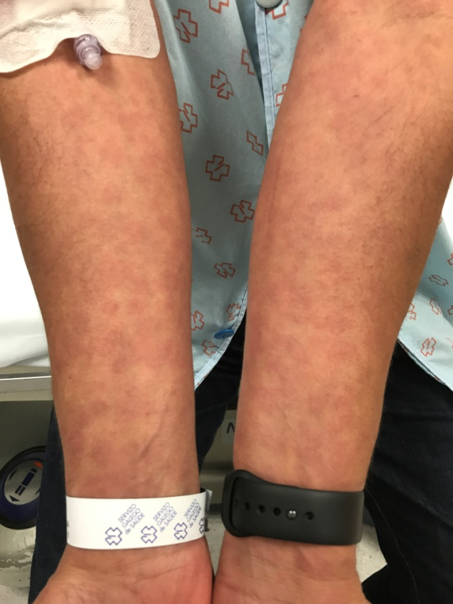
Fotos: Dra Carmen Peña

Slide 15
Foto: Dra Carmen Peña

Slide 16
¿Cómo llegamos al diagnóstico?
Historía clínica y exploración física
Descartar otras posibles etiologías (infecciones, otros fármacos, otras enfermedades)
Análisis de sangre y orina (hemograma, perfil hepático, renal, serologías, anticuerpos)
Biopsia cutánea si hay indicación
Seguimiento estrecho de los pacientes cada 3-7 días

Slide 17
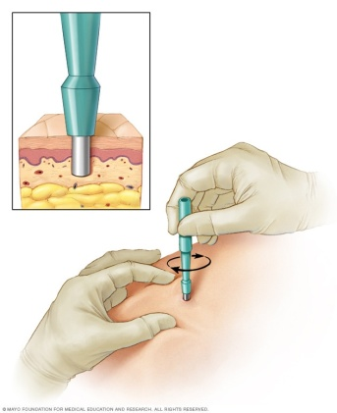
¿Cuándo biopsiar?
Erupción atípica
Severa
Persistente
Recurrente
Síntomas intolerables
Notes:
The most common
feature is an eczema-like spongiotic dermatitis with associated
superficial perivascular T-lymphocyte infiltrate
which can extend to epidermis, patchy necrotic keratinocytes
and scattered to florid eosinophils, muy parecido a una reaccion de hipersensibilidad

Slide 18
Exantemas/Dermatitis inflamatorias
Erupción morbiliforme
Eritema multiforme
Erupción liquenoide (anti PD-1 / PDL-1)
Eccema (anti PD-1 / PDL-1)
Erupción psoriasiforme (anti PD-1 / PDL-1)
Dermatosis neutrofílicas :
Sd. Sweet (anti-CTLA-4)
Pioderma gangrenoso (anti-CTLA-4)
Reacciones de fotosensibilidad
Dermatitis asociadas a radiación
Reacciones similares a lupus
Sarcoidosis
Dermatomiositis (anti CTLA-4)
Paniculitis tipo eritema nudoso (anti CTLA-4 + anti PD-1/PDL-1)
Notes:
1.1 Rash/inflammatory dermatitis
Definition: Erythema multiformeminor (a targetoid reaction in the skin and mucous membranes usually triggered by infections, such as herpes simplex viruses, but can be associated with an immune-related drug eruption and if progresses to erythema multiformemajor, it and can be a harbinger of SCAR, such as SJS), lichenoid
(resembling the flat-topped, polygonal, and sometimes scaly or hypertrophic lesions of lichen-planus), eczematous (inflammatory dermatitis characterized by
pruritic, erythematous, scaly, or crusted papules or plaques on the skin, which is vulnerable to superinfection, psoriasiform [resembling the well-demarcated,
erythematous, and scaly papules and plaques of psoriasis], morbilliform [a nonpustular, nonbullous measles-like exanthematous rash of the skin often referred
to as “maculopapular” and without systemic symptoms or laboratory abnormalities, excluding occasional isolated peripheral eosinophilia, palmoplantar
erythrodysesthesia [hand-foot syndrome; redness, numbness, burning, itching, and superficial desquamation of the palms and soles], neutrophilic dermatoses
[eg, Sweet syndrome], and others)

Slide 19
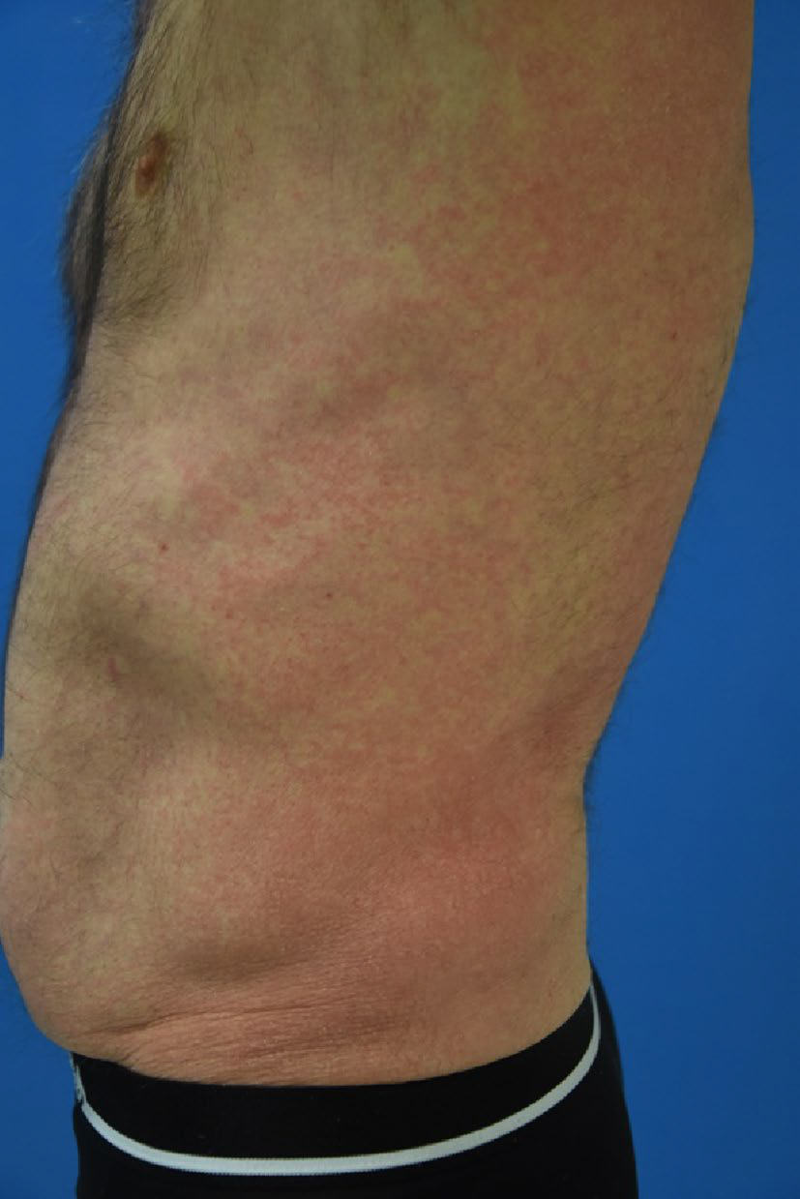
Erupción morbiliforme
Erupción máculopapular
Tronco Extremidades
Suele respetar la cara, palmas y plantas
Generalmente pruriginosas o urentes
Fotoagravamiento
Puede haber eosinofilia periférica (anti CTLA-4)
Lacouture M et al. Am J Clinic Dermatol 2018; 19 (Suppl 1):S31–S39

Slide 20
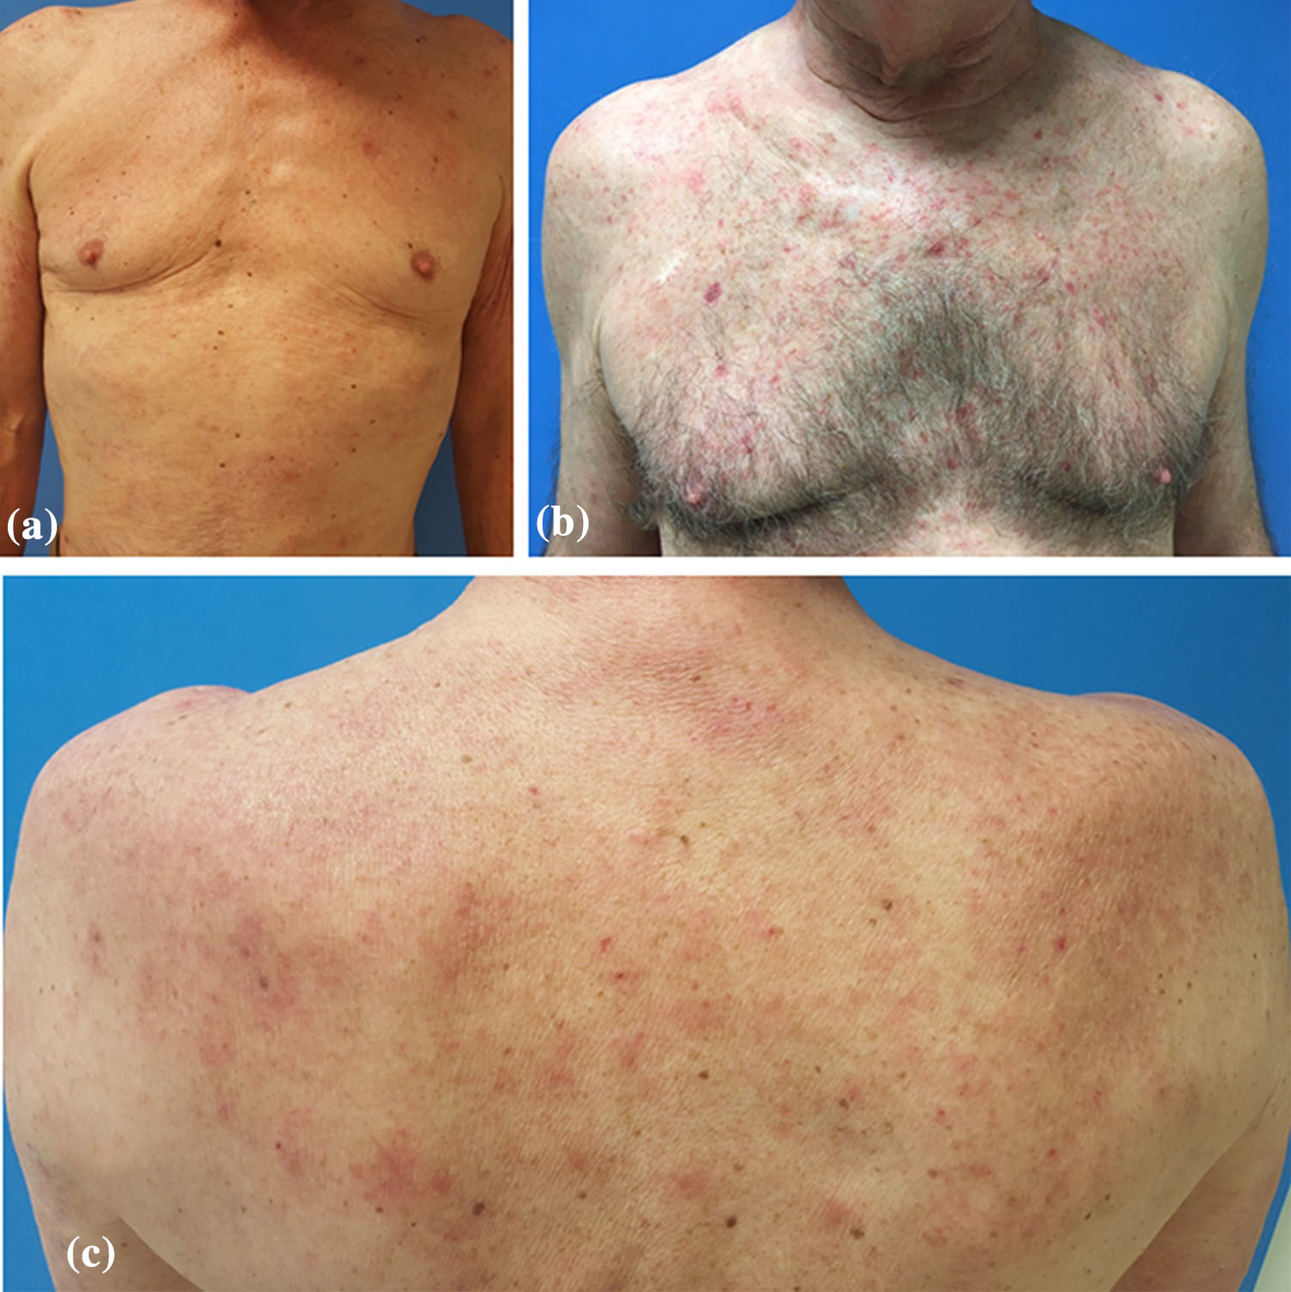
Erupción morbiliforme
Sibaud V. Am J Clin Dermatol 2018;19:345-61

Slide 21
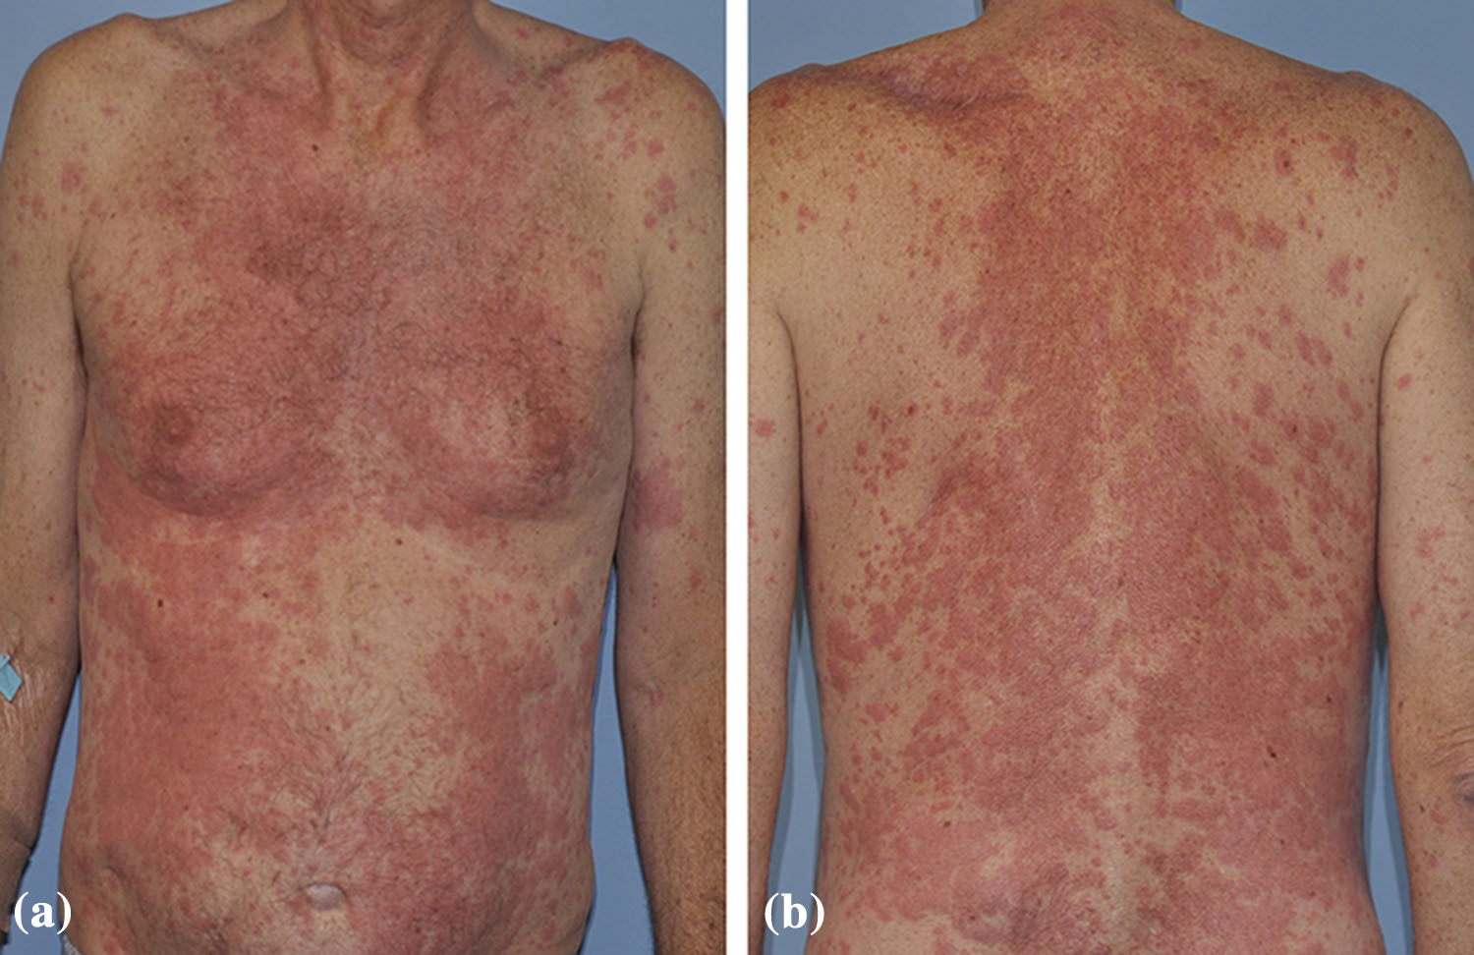
Erupción morbiliforme
Sibaud V. Am J Clin Dermatol 2018;19:345-61

Slide 22
Erupción morbiliforme
Sibaud V. Am J Clin Dermatol 2018;19:345-61

Slide 23
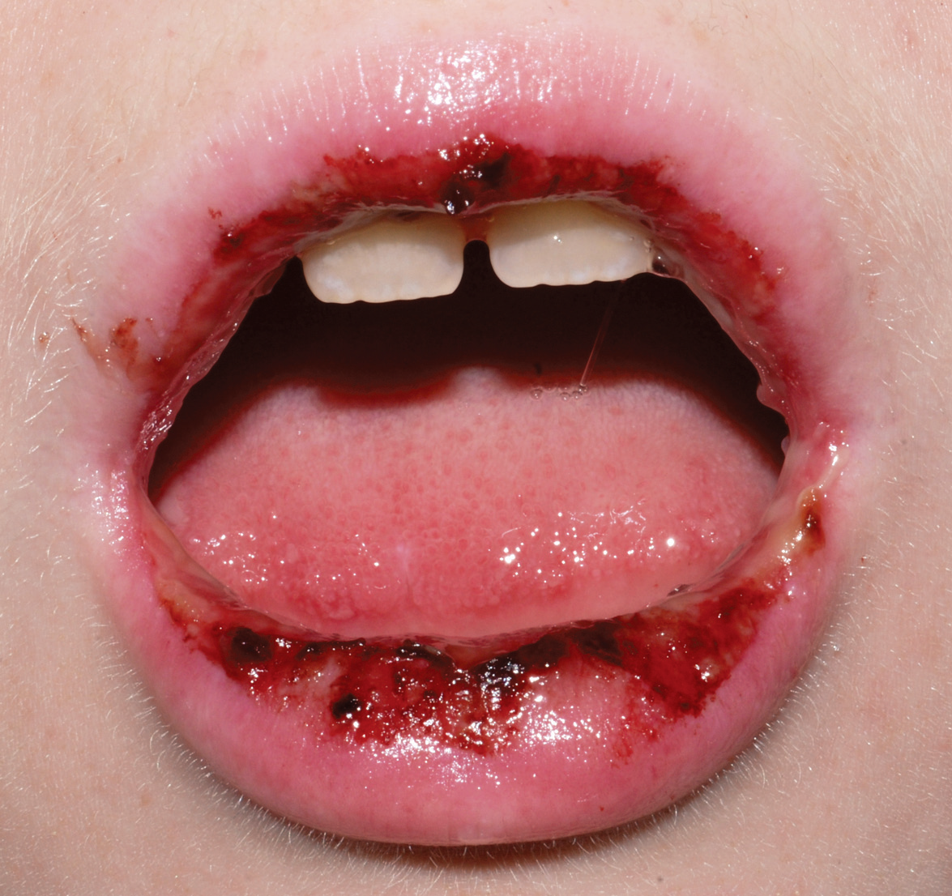
Eritema multiforme
Lesiones en diana
Aparición brusca (< 24-72 h)
Pruriginosas, urentes
Autolimitada, potencialmente recurrente
2 tipos de lesiones:
Típicas: ≥ 3 zonas diferentes, ampollas
Atípicas o papulares: 2 zonas diferentes , bordes menos definidos.
Simétricas, zonas acrofaciales
Duración: 1-2 sem > inmunosupresores o ICPi
Notes:
Lesiones en diana, de aparición brusca (< 24-72 horas), pruriginosas o urentes
Autolimitada, potencialmente recurrente
2 tipos de lesiones:
Típicas, con al menos 3 zonas diferentes
Atípicas o papulares, con solo dos zonas diferentes y con bordes menos definidos.
Predominan en zonas acrofaciales, simétricas
Duración 1-2 semanas, más si hay agentes inmunosupresores

Slide 24
Eritema multiforme
Diagnóstico: Correlación clínico-patológica:
Apoptosis de queratinocitos
Degeneración vacuolar focal de la membrana basal
Edema superfial de la dermis e infiltrado perivascular linfocitario con exocitosis en epidermis
Notes:
Histopatologia
Es una diagnostico clinicopatologico, no puramente histologico.
Son hallazgos característicos:
Queratinocitos son las celulas objeto de daño con apoptosis, siendo el hallazgos más precoz.
Posteriormente espongiosis leve con degeneración vacuolar de la MB de forma focal
Edema superficial de la dermis e infiltrado perivascular linfocitario con exocitosis en la epidermis.

Slide 25
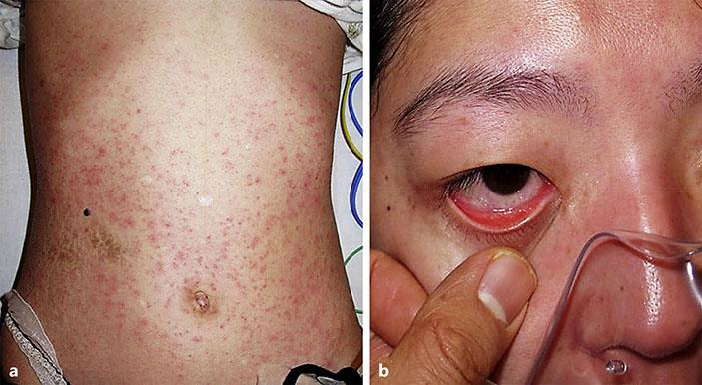
Eritema multiforme
Notes:
The most common
feature is an eczema-like spongiotic dermatitis with associated
superficial perivascular T-lymphocyte infiltrate
which can extend to epidermis, patchy necrotic keratinocytes
and scattered to florid eosinophils, muy parecido a una reaccion de hipersensibilidad

Slide 26
Eritema multiforme
JAMA Dermatology 2018. doi:10.1001/jamadermatol.2018.1912
Notes:
He received pembrolizumab for metastatic
melanoma 38.0 months before the onset of painful red
plaques and blisters on his palms (Figure, A) and several oral
mucosal erosions.Results of biopsies of specimens taken from
the palms showed a patchy inflammatory infiltrate composed
of lymphocytes and eosinophils approximating the
dermal-epidermal junction, with basovacuolar change and
scattered dyskeratotic keratinocytes in the epidermis (Figure,
B), indicative of erythema multiforme. The eruption resolved
with a course of prednisone therapy but reappeared
after his next cycle of pembrolizumab therapy.

Slide 27
Notes:
The manifestations
of our case mimicked severe drug eruption, as
observed with Stevens–Johnson syndrome (SJS). However,
there was no epidermal necrosis in histology; thus, the possibility
of SJS was excluded.

Slide 28
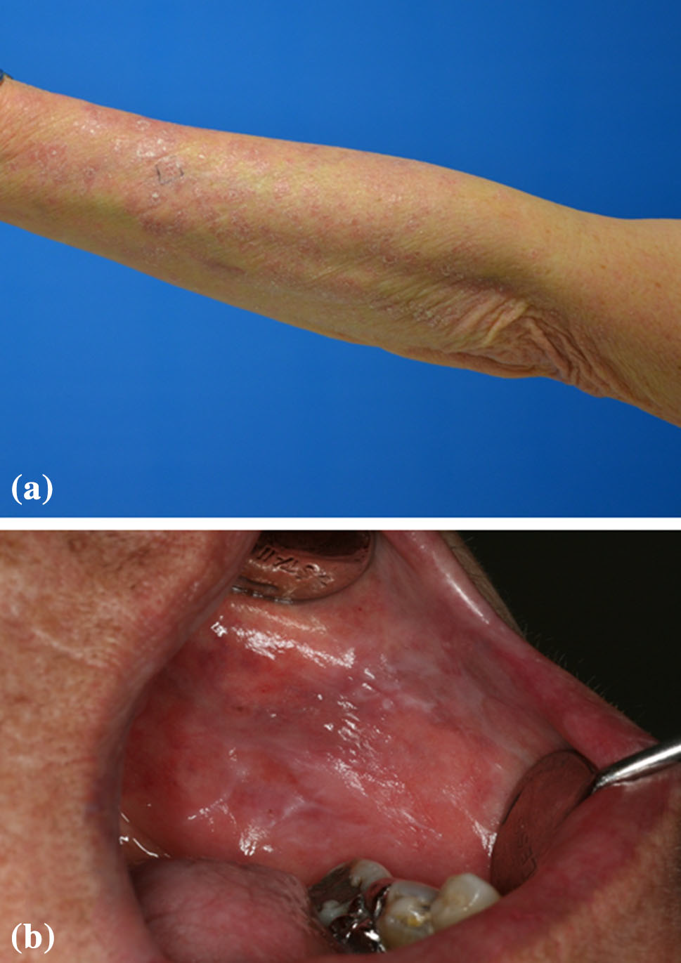
Erupción liquenoide
Anti PD-1 (17%) y PDL-1
42 días -14 meses
Pápulas y placas pigmentadas, eritemato-violáceas/hiperqueratósicas
Simétricas: tronco y extremidades
Puede afectar mucosas, uñas
Asintomáticas/Prurito severo
Sibaud V. Am J Clin Dermatol 2018;19:345-61
Hwang S et al. J Am Acad Dermatol 2016;74:455-61

Slide 29
Erupción liquenoide
JAMA Dermatol 2016;152(10):1128-36

Slide 30
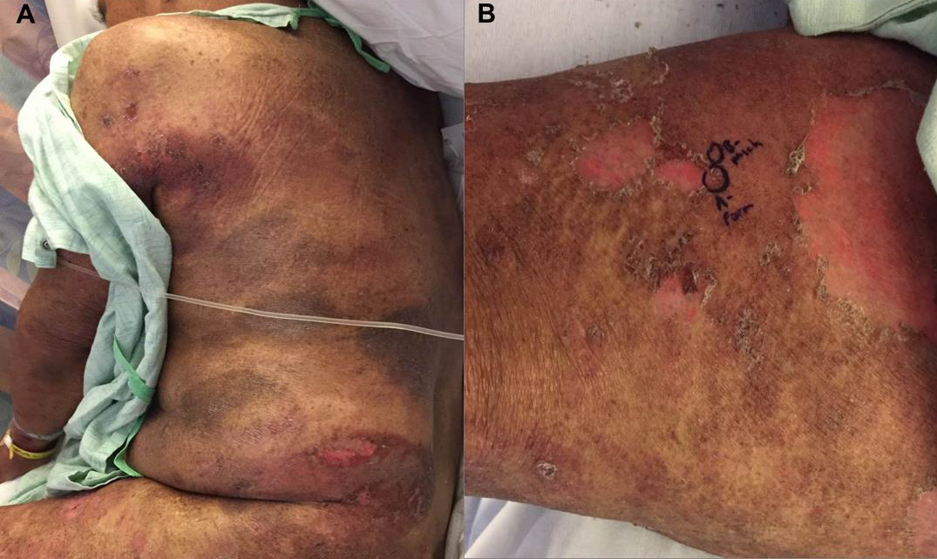
Erupción liquenoide
Davis MJ et al. Dermatology Online J 2018;24(4):13
Notes:
Histopathologically, a
lichenoid reaction with band-like lymphocytic infiltration
(CD4+, CD8+ or mixed CD4+/CD8+ infiltrate) is observed
in the upper dermis, sometimes together with the presence of
eosinophils [35]

Slide 31
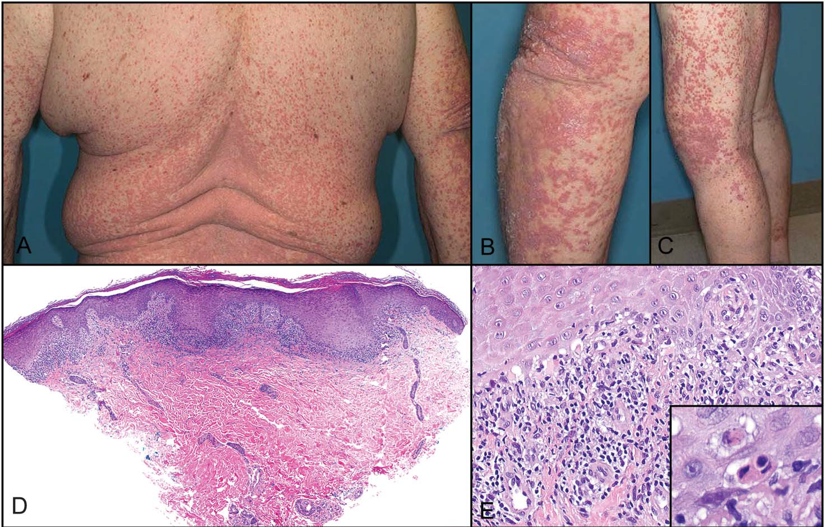
Erupción liquenoide
Tetzlaff MT et al. Am J Dermatopathol 2017;39:121–129)
Notes:
Histopathologically, a
lichenoid reaction with band-like lymphocytic infiltration
(CD4+, CD8+ or mixed CD4+/CD8+ infiltrate) is observed
in the upper dermis, sometimes together with the presence of
eosinophils [35]

Slide 32
Erupción liquenoide
Notes:
Histopathologically, a
lichenoid reaction with band-like lymphocytic infiltration
(CD4+, CD8+ or mixed CD4+/CD8+ infiltrate) is observed
in the upper dermis, sometimes together with the presence of
eosinophils [35]

Slide 33
Erupción psoriasiforme
Psoriasis de novo o exacerbaciones tanto con anti-CTLA-4 y anti-PD1/PDL-1
Placas eritematosas, descamativas, bien delimitadas
Tronco, extremidades, palmas, plantas, pliegues, cara y cuero cabelludo
Generalmente asintomáticas

Slide 34
Erupción psoriasiforme
Sibaud V. Am J Clin Dermatol 2018;19:345-61

Slide 35
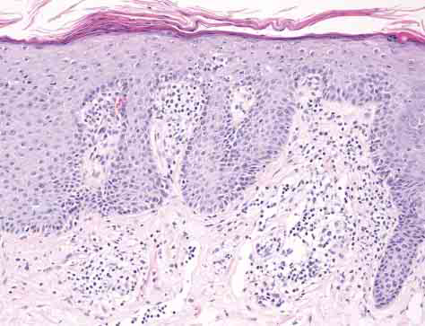
Erupción psoriasiforme
Occurrence of Psoriasiform Eruption
During Nivolumab Therapy for Primary
Oral Mucosal Melanoma
Ohtsuka M et al. JAMA Dermatol 2015; 151:797–799.

Slide 36
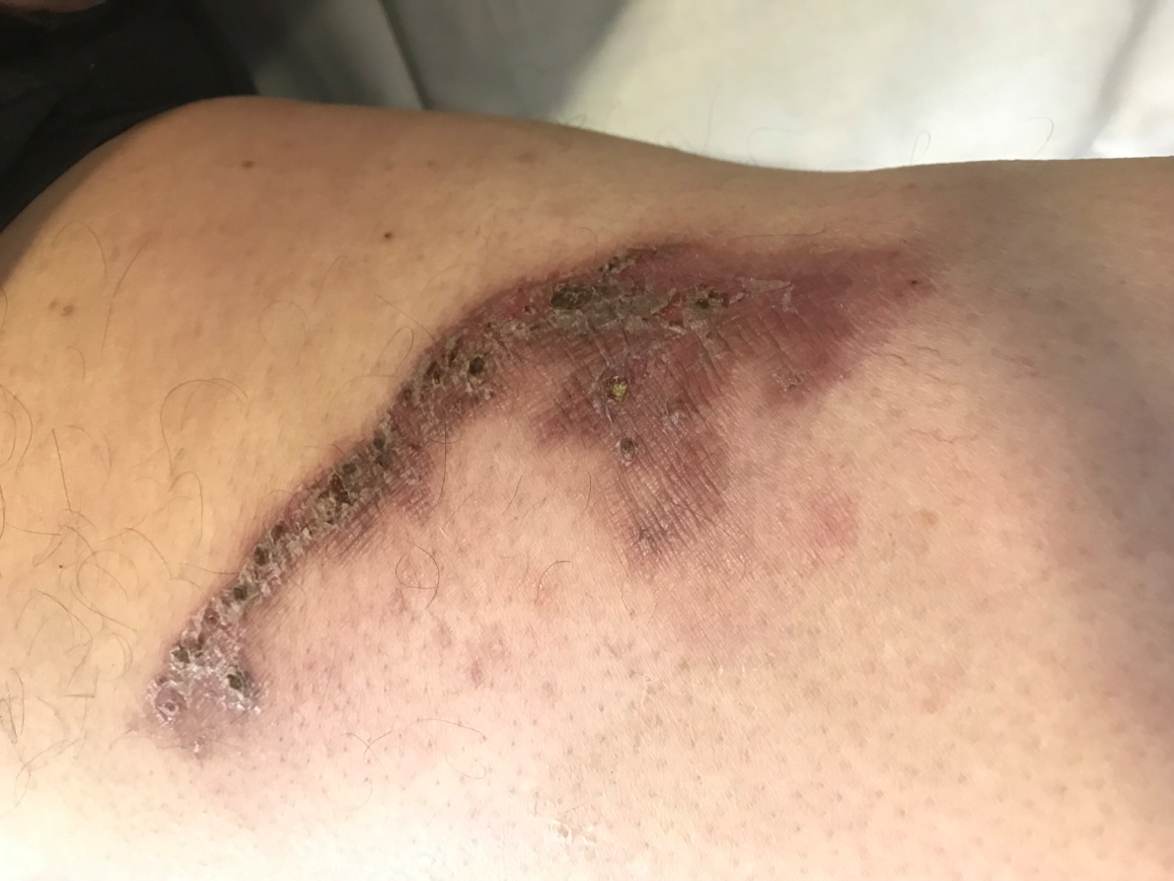
Erupción psoriasiforme

Slide 37
Eccema
Anti-PD1 (17%) y anti-CTLA-4
Más frecuente en la espalda y extremidades
Formas de presentación: placas eritematosas, descamativas y mal definidas, placas de eccema numular o prúrigo nodular.
Prurito (10%-30%) + Xerosis+ Excoriaciones
Puede existir combinación de erupción liquenoide + eccema / erupción psoriasiforme + eccema
Hwang S et al. J Am Acad Dermatol 2016;74:455-61
Notes:
Eczema
Of 14 patients (8 male) who developed eczema, 7
had previous ipilimumab exposure. There was no
statistically significant association between the distribution
of time from commencement of treatment
to first eczema and previous ipilimumab exposure
(log rank test P = .514), gender (log rank test
P = .968), or age (Cox regression P = .188).
The median age of patients who did and did not
develop eczema was 69.5 years (interquartile range
59.0-75.0 years) and 60 years (interquartile range
52.5-69.0 years), respectively.
Lesions appeared on multiple sites, most
commonly on the back and lower or upper limbs,
less frequently on the face, chest, and abdomen. The
clinical presentation varied from classic eczema
(ill-defined erythematous scaly lesions) to multiple
nummular plaques. The lesions were pruritic in most
cases.
As seen in Fig 1, the incidence of developing
eczema increases at an approximately constant rate
after commencement of treatment. A quarter of
patients (cumulative incidence rate 25%, SE 7.1%)
are expected to develop their first eczema within
10.3 months of commencing treatment and one third
of patients (cumulative incidence rate 33%, SE 9.1%)
are estimated to develop the first eczema within
13.8 months of commencing treatment, increasing
to an estimated 40% of patients (cumulative
incidence rate 40%, SE 11.2%) within 20.0 months
of commencing treatment.

Slide 38
Paniculitis tipo eritema nudoso
Notes:
describe two patients who developed multiple subcutaneous erythema
nodosum-like painful nodules while receiving combined immunotherapy with ipilimumab
and nivolumab for metastatic clear cell ovarian carcinoma and melanoma

Slide 39
Lupus eritematoso cutáneo
Shao K et al. J Cutan Pathol. 2018 ;45(1):74-77
Notes:
the first report of lupus-like histopathologic findings that developed as an
irAE to a PD-1 inhibitor.
Nearly two and a half months after his last dose of pembrolizumab was given (seven
months after initiation), the patient presented with an erythematous and non-pruritic eruption of
edematous papules coalescing into plaques on his back, chest, lateral arms, thighs, and abdomen
(Figure 1). At the time of the rash’s presentation, a review of systems was negative and the
patient’s complete blood count, electrolytes, and liver function tests were stable. A biopsy of the
back and of the arm was performed, and revealed an interface reaction, with lymphocytes at the
dermal-epidermal junction, and occasional dyskeratotic keratinocytes (Figure 2). Perivascular
and perifollicular lymphocytic inflammation was seen. Rare eosinophils were observed. PAS
staining did not reveal basement membrane thickening. Alcian blue staining showed a slight
increase in mucinous ground substance. These features were interpreted as a lupus-like
medication reaction. Based on these findings, pembrolizumab continued to be withheld in the
patient. Within one month, the rash completely resolved without use of topical steroids or other
topical medications. The patient was not restarted on pembrolizumab.Biopsy showing lichenoid interface changes on scanning magnification and as well as a superficial
to mid dermal perivascular lymphocytic infiltrate (hematoxylin-eosin stain, original magnification: x20 for A,
x50 for B). C) Interface dermatitis, with lymphocytes approximating the dermal-epidermal junction and
basovacuolar change (original magnification: x2

Slide 40
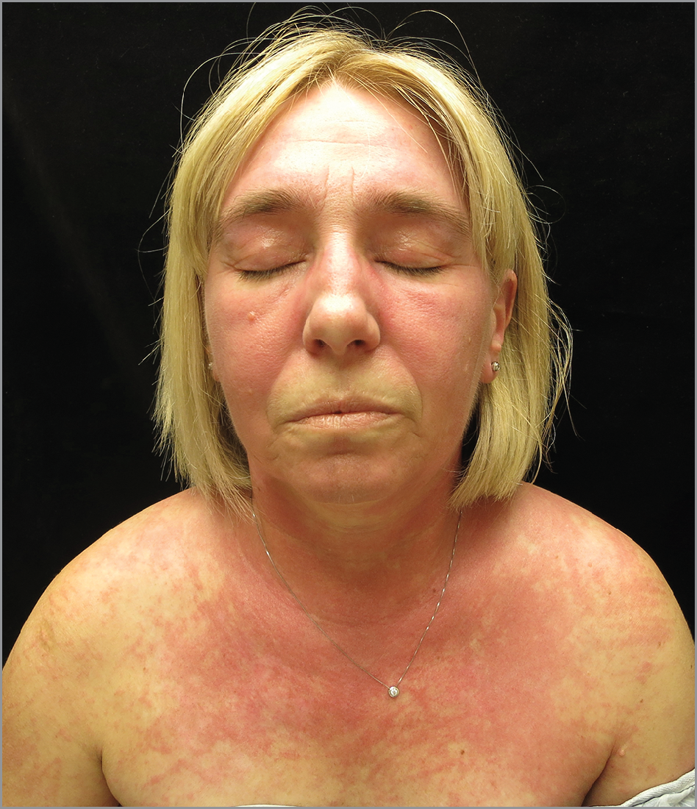
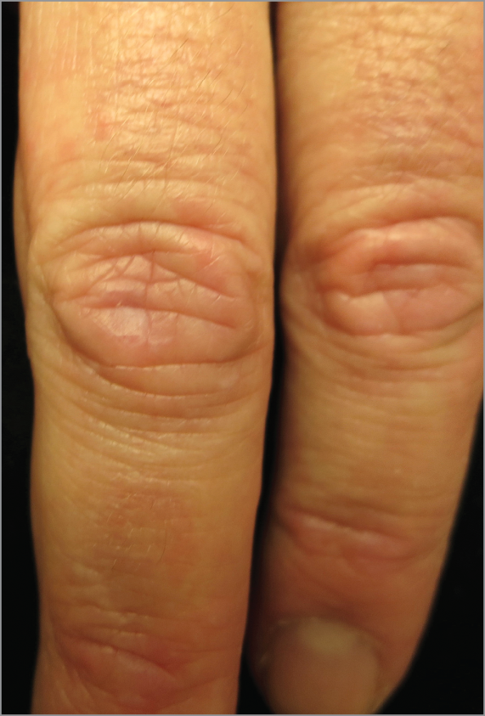
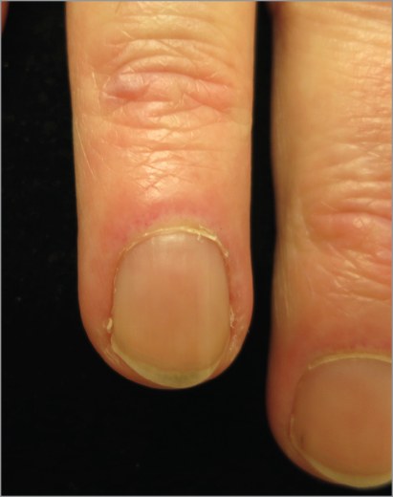
Dermatomiositis
Sheik Ali S et al. JAMA Dermatology. 2015;151(2):195
Notes:
Photodistributed,
erythematous
eruption on face
and upper chest,
erythematous
papules over
dorsal hand, nail
fold and eyelid
erythema, muscle
Weakness
Although most cases of dermatomyositis are idiopathic, 15% to 30% of adult-onset cases occur as a paraneoplastic syndrome.¹¹ In light of this patient’s known malignant melanoma, a paraneoplastic presentation of dermatomyositis could be considered, although dermatomyositis is only rarely associated with melanoma and the timing suggests a drug-related cause in this particular case. The recurrence of symptoms following rechallenge with ipilimumab points to a drug-induced presentation. Importantly, although the patient initially presented and then re-presented with metastatic disease, she developed findings of dermatomyositis only following administration of ipilimumab on both occasions, making a paraneoplastic presentation of dermatomyositis less likely. Some data on paraneoplastic rheumatic diseases suggest that the immune response to cancer is highly associated with the autoimmune disease.¹² It is possible that ipilimumab administration could alter the immune response to an underlying malignancy, hence requiring both the presence of the drug and the malignancy to develop this irAE. Given ipilimumab’s current indications, it will be challenging to learn whether ipilimumab alone could result in drug-induced dermatomyositis in the absence of an underlying malignancy.
No esta descrita con anti-PD1

Slide 41
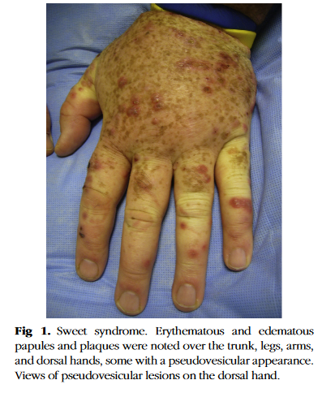
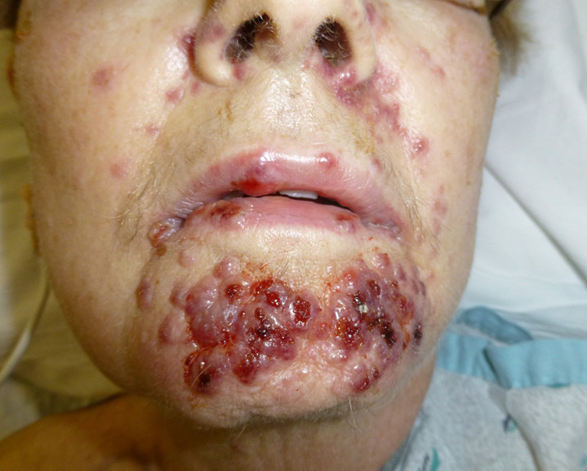
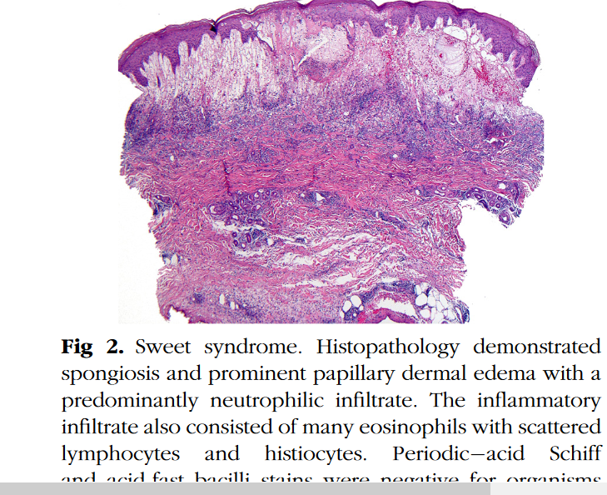
Dermatosis neutrofílica tipo Sweet
Papulas, nódulos y placas eritematosos, pseudovesiculoso, dolorosos
Tronco, extremidades, manos, cara
Puede cursar con fiebre
Kyllo RL et al. J Am Acad Dermatol 2014;70:e85-6.
Gormley R et al. J Am Acad Dermatol 2014; 71: e211.
Notes:
La histopatología además del importante edema en papilas dermicas, un infiltrado predominantemente neutrofílico.
Y se podría pensar en un fenomeno paraneoplasico, pero la verdad es la mayoría empiezan en las primeras semanas del inicio de la terapia con inhibidores, en ausencia de evidencia de progresión de la enfermedad y desaparecen tras la suspensión del tto.
Solo se ha asociado al tto con ipilimumab

Slide 42
Sarcoidosis
Anti-CTLA-4 y anti-PDL-1
Pápulas firmes, aisladas o en placas, nódulos subcutáneos
Suele existir afectación sistémica
Suozzi KC et al. JAAD Case Rep. 2016;2:264–8.
Notes:
It is characterized by intense, painful erythema of the palms and soles that can progress to the formation of vesicles or bullae

Slide 43
Dermatitis herpetiforme
Notes:
Patient 2 developed dermatitis herpetiformis
while receiving ipilimumab. The pathogen-
esis of dermatitis herpetiformis and celiac
disease relies on T-cell stimulation by tissue
transglutaminase-modified gliadin and the ensu-
ing inflammatory response.
29
–
32
Autoantibodies
against tissue transglutaminase and gliadin, par-
ticularly of the IgA subtype, are present in both
dermatitis herpetiformis and celiac disease.
29
One study found that T-regulatory cells were
reduced in the skin of patients with dermatitis
herpetiformis.
33
Although Patient 2 had anti-tissue transglu-
taminase antibodies identified during an evalua-
tion for weight loss prior to immunotherapy, the
patient’s dermatitis herpetiformis did not appear
until after several weeks of receiving ipilimumab.
To our knowledge, the phenomenon of der-
matitis herpetiformis appearing after immune
checkpoint inhibitor therapy has not been pre-
viously reported. The clinicopathologic scenario
of Patient 2 would be consistent with a disinhi-
bition of the autoimmune process of dermatitis
herpetiformis and, similar to Patient 1, may sug-
gest a role for T-regulatory cells in the pathogen-
esis of the disease

Slide 44
Penfigoide ampolloso

Slide 45
Notes:
Tregs and the PD-1 : PD-ligand (PD-L) pathway are
both critical in terminating immune response, and
elimination of either can result in the breakdown of
tolerance and the development of autoimmunity.7
T-helper reactivities against BP180 were detected in
most patients with BP in a 2006 study.1 Both T-helper
(Th)1 and Th2 chemokines were found to be elevated
in the sera of patients with autoimmune blistering diseases,
8 while Tregs were found to be present in BP
and mucous membrane pemphigoid lesions.2,9,10 Our
patient developed BP with increasing titres of anti-
BP180 IgG autoantibodies and increasing disease
severity. Other autoantibodies such as anti-BP230,
anti-Dsg1 and anti-Dsg3 were not detected. These
results may indicate a crucial role for T-cell suppressive
activity in controlling and preventing BP.

Slide 47
Enfermedad de Grover
Anti-CTLA-4 y PD-1
Pápulas queratósicas o papulo-vesículas, pruriginosas
Tronco, extremidades superiores
Aparecen precozmente
Confirmación histológica
Koelzer VH et al. J Immunother Cancer 2016;4:47.
Notes:
It is characterized by intense, painful erythema of the palms and soles that can progress to the formation of vesicles or bullae

Slide 48
Repigmentación de canas

Slide 49
¿Cuándo una toxicodermia es grave?
Signos de gravedad cutánea
Signos sistémicos:
Fiebre ≥ 38 ⁰C
Adenopatías
Hipotensión
Disnea
Artralgias/artritis
Alteraciones analíticas:
Eosinofília
Linfocitosis atípica
Elevación de enzimas hepáticas
Disfunción renal

Slide 50
Signos de gravedad cutánea
Eritema confluente
Púrpura palpable
Necrosis cutánea
Ampollas, pústulas o erosiones
Dolor cutáneo sobre zonas de eritema/eritema oscuro
Nikolsky positivo:
Presión tangencial a la superficie cutánea
Edema facial, lingual o en extremidades
Urticaria extensa
Mucositis
Desprendimiento epidérmico

Slide 51
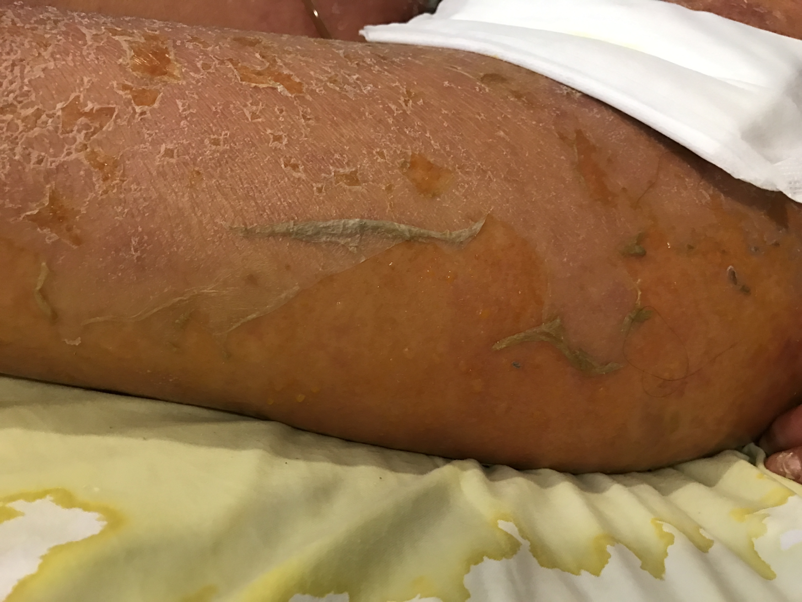
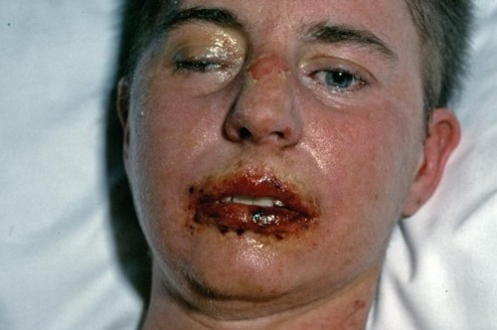
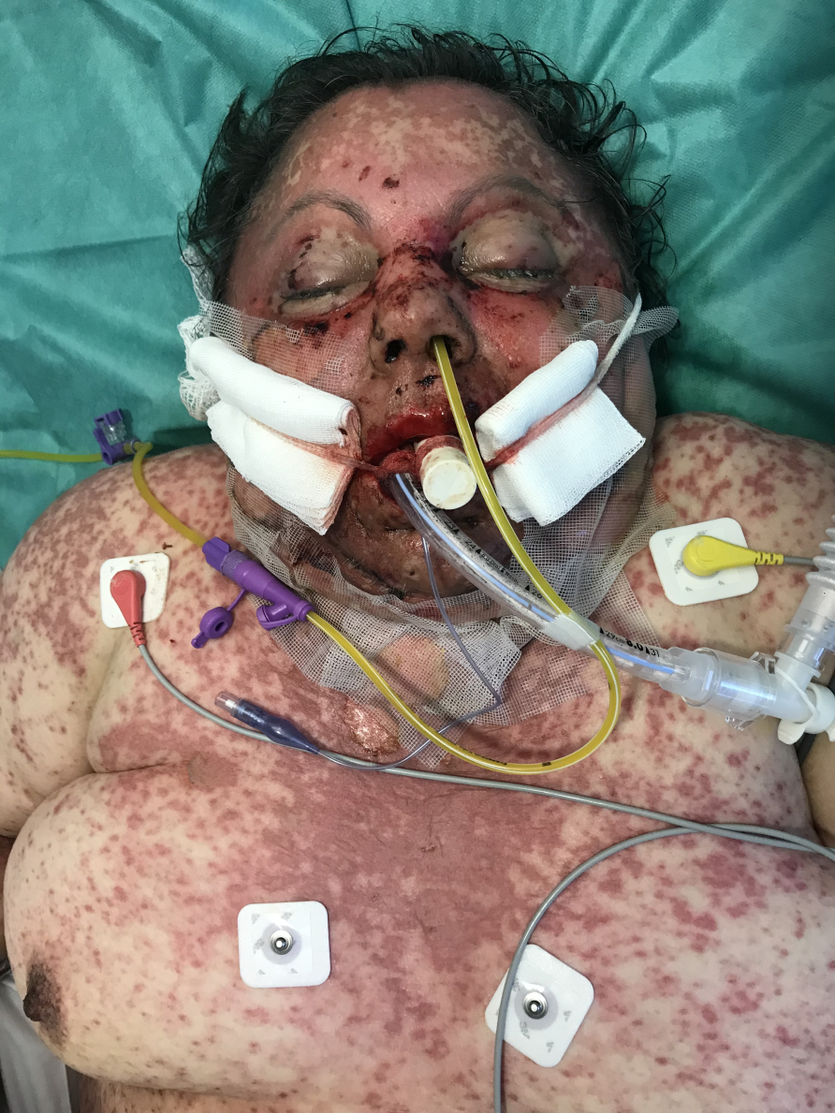
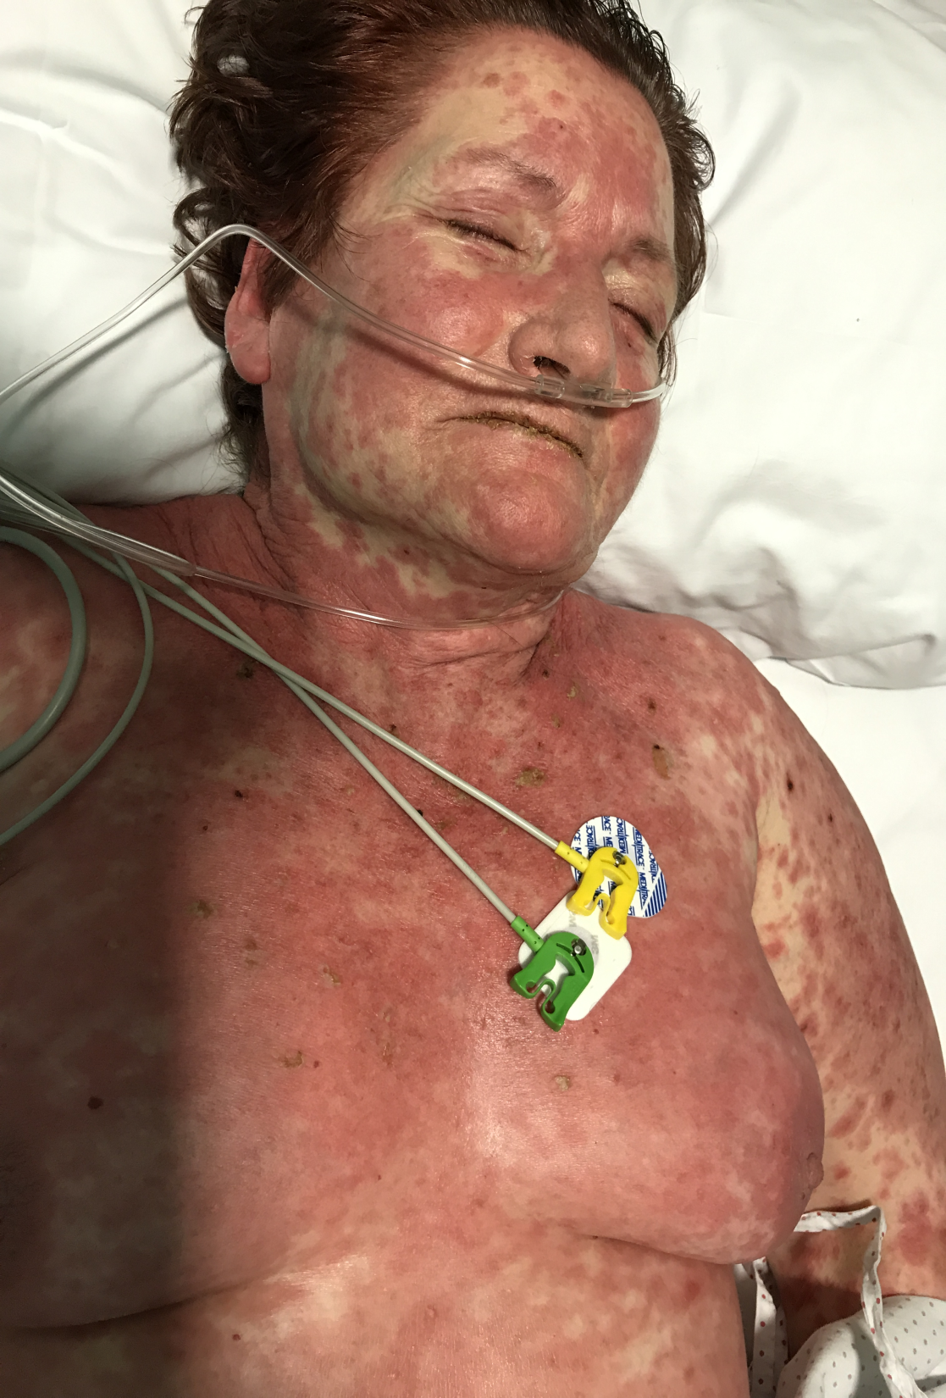
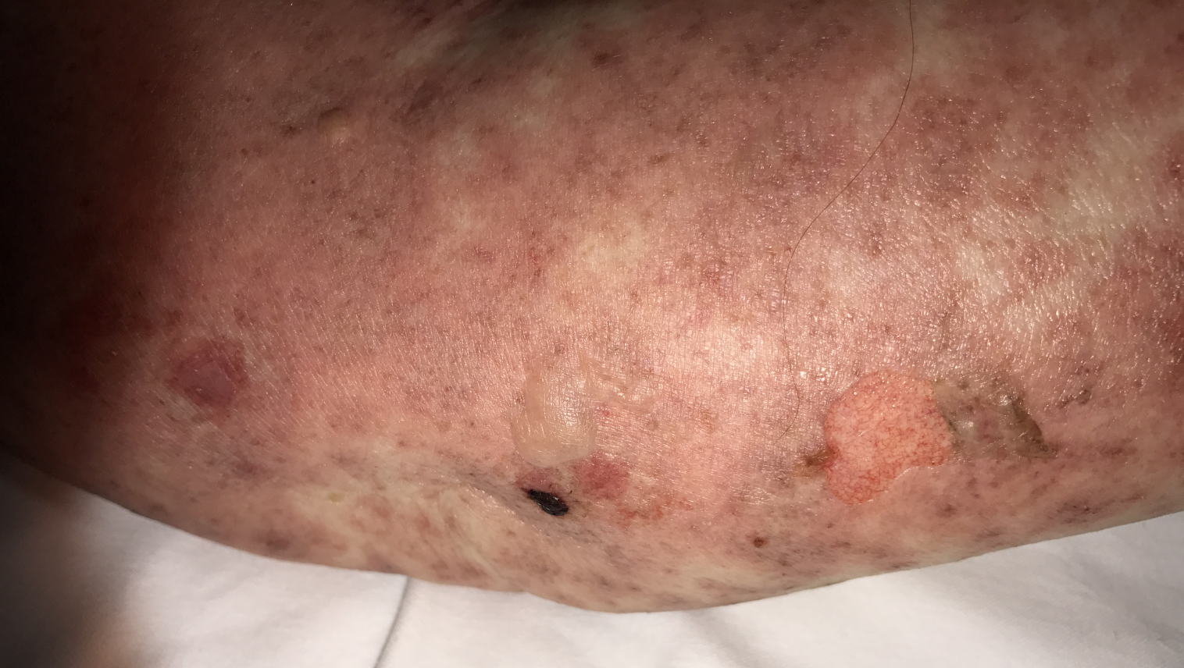
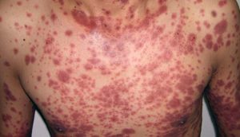

Slide 52
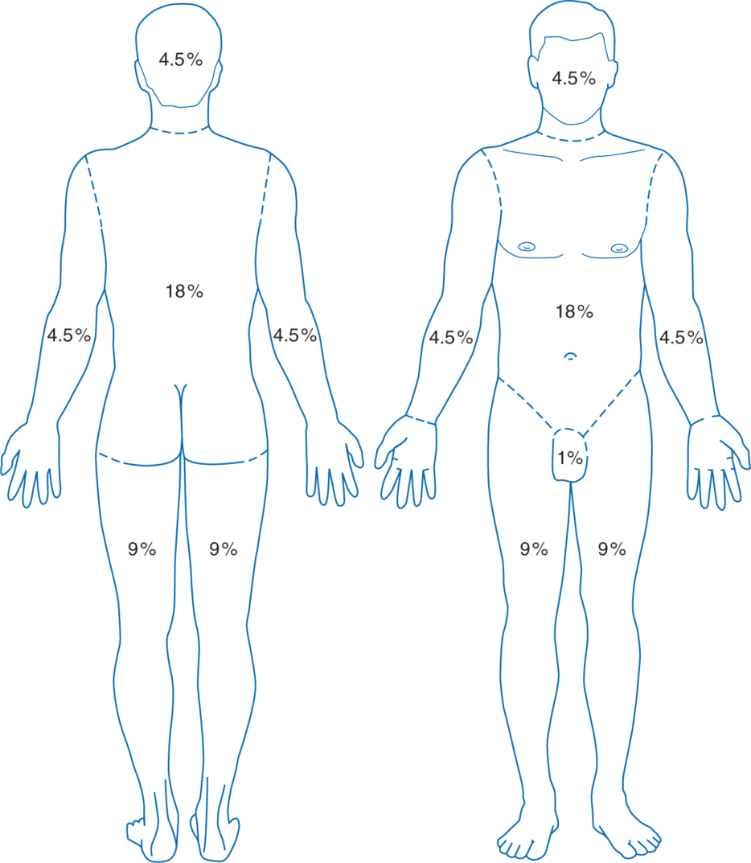
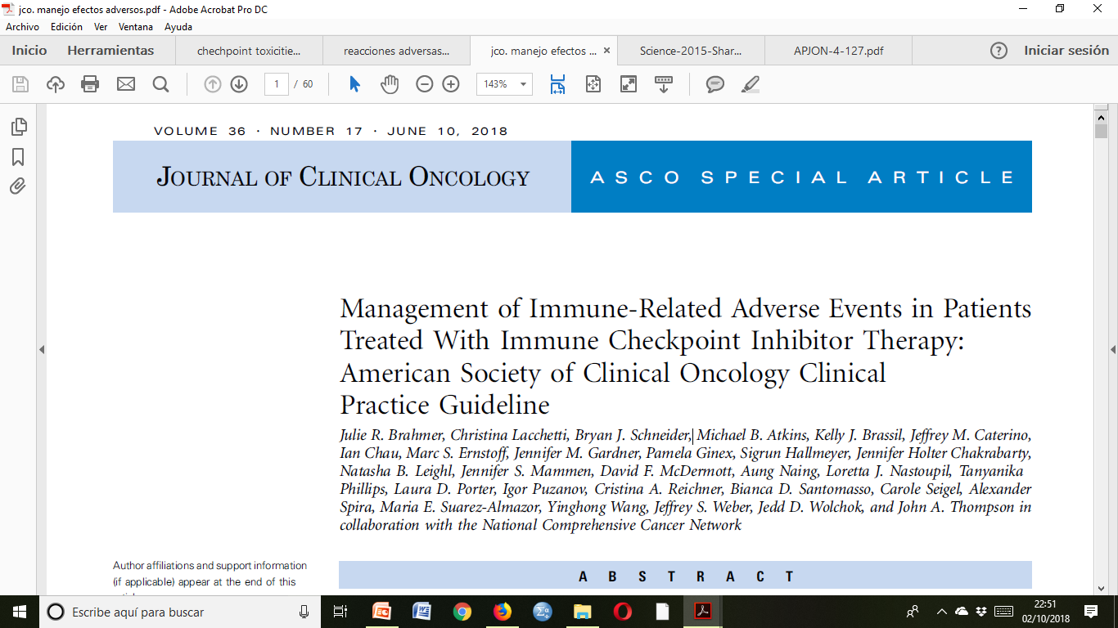
Grados de severidad Prurito/Exantemas
Grado 1: Síntomas no afectan la calidad de vida o son controlados con tratamiento tópico o antihistamínicos orales
Grado 2: Síntomas afectan la calidad de vida y requieren intervención según diagnóstico
Grado 3: No responde a las medidas tomadas en el grado 2
Grado 4: Inmanejable e intolerable con las medidas previas.
Grado 4: Reacciones que amenazan la vida
Grado 3: Máculas/pápulas > 30% ASC c/s síntomas ; limitando AVD de auto-cuidado
Common Terminology Criteria for Adverse Events (CTCAE) v5.0 (2017)
Grado 2: Máculas/pápulas 10%-30% BSA c/s síntomas ; limitando actividades de la vida diaria (AVD) instrumentales
Grado 1: Máculas/pápulas < 10% área de superficie corporal (BSA) c/s síntomas

Slide 53
Grados de severidad
Dermatosis ampollosas/Reacciones severas
Grado 1: No aplicable
Grado 2: Exantema 10-30% BSA, c/síntomas sistémicos, linfaadenopatías, o edema facial
Grado 3: Desprendimiento cutáneo < 10% BSA, con signos sistémicos, afectando mucosas
Grado 4: Eritema y desprendimiento cutáneo ≥ 10% BSA, con síntomas y signos sistémicos, o de análisis de laboratorio (DRESS/DIHS)
Grado 4: Ampollas > 30% BSA c/alteraciones hidroelectrolíticas
Grado 3: Ampollas > 30% BSA c / síntomas ; limitando AVD de auto-cuidado
Dermatosis
ampollosas
Grado 2: Ampollas 10%-30% BSA c/s síntomas ; afectando la calidad de vida
Grado 1: Ampollas < 10% área de superficie corporal (BSA) s/ síntomas y sin eritema
Reacciones severas
Common Terminology Criteria for Adverse Events (CTCAE) v5.0 (2017)

Slide 54
Manejo del prurito
Melanoma Manag.(2017) 4(4), 187–20

Slide 55
Manejo de los exantemas
Emolientes, corticoides tópicos de mediana potencia, antihistamínicos orales
Idem
Corticoides de mediana-alta potencia
Prednisona 0,5-1 mg/Kg/día por 4 semanas
Valorar suspender el ICPi
Avisar a Dermatología
Idem
Corticoides de alta potencia
Metilprednisona 1 -2 mg/Kg/día por al menos 4 semanas
Suspender los ICPi
Valorar reintroducción de los ICPi
Melanoma Manag.(2017) 4(4), 187–20
Brahmer JR et al. J Clin Oncol 2018;36(17):1714–68.

Slide 56
Manejo de las dermatosis ampollosas
Cuidados generales de la piel: vaselina, dimeticona
Idem
Consultar al dermatólogo
Corticoides de alta potencia
Prednisona 0.5-1 mg/Kg/día un mínimo de 4 semanas
Suspender los ICPi
Idem
Metilprednisolona -2 mg/Kg/día un mínimo de 4 semanas
Rituximab
Valorar con dermatología si puede reiniciarse los ICPi
Idem
Cese definitivo de los ICPi
Melanoma Manag.(2017) 4(4), 187–20
Brahmer JR et al. J Clin Oncol 2018;36(17):1714–68.

Slide 57
Manejo de las reacciones severas
Suspender los ICPi si se sospecha NET/SSJ
Consultar al dermatólogo
Uso de vaselina, dimeticona, emolientes, corticoides tópicos de mediana –alta potencia, antihistamínicos orales
Prednisona 0.5-1 mg/Kg/día por 4 semanas
Idem
Metilprednisolona 1-2 mg/Kg/día un mínimo de 4 semanas
Valorar con dermatología si puede reiniciarse los ICPi
Idem
Cese definitivo de los ICPi
Ingreso en una unidad de cuidados intensivos/quemados
Valorar uso de ciclosporina e Inmunoglobulina IV si no respuesta
Brahmer JR et al. J Clin Oncol 2018;36(17):1714–68.

Slide 58
Manejo de las toxicidades cutáneas

Slide 59
Ideas para llevar a casa
Las toxicidades dermatológicas representan los efectos adversos (EA) más frecuentes de los inhibidores de punto de control inmune (ICPi)
El prurito y los exantemas morbiliformes representan los EA cutáneos más frecuentes de los ICPi
Los EA cutáneos parece relacionarse con un mejor pronóstico en cáncer de pulmón no células pequeñas (CPNCP)
Debe solicitarse la valoración del dermatólogo y suspender los ICPi en casos de severidad ≥ grado 2 muy sintomáticos / signos de gravedad cutánea
El manejo de los EA cutáneos por lo general implica el uso de antihistamínicos orales y corticoides tópicos de mediana/alta potencia
El uso de corticoides sistémicos, así como la suspensión de los ICPi, no empeoran el pronóstico de supervivencia a largo plazo en CPNCP
Notes:
It is characterized by intense, painful erythema of the palms and soles that can progress to the formation of vesicles or bullae

Slide 60
Toxicidades dermatológicas de la inmunoterapia del cáncer de pulmón
Dra. María del Pilar Arévalo Bermúdez, MD, PhD
Complejo Hospitalario Universitario A Coruña

